Slide 1
Generative AI
Submitted by : Drishti Gupta
Batch : AIML
Roll No. : 2322825
Submitted To : Mr. Devashish Sir

Slide 2


INDEX
I
Introduction
Types
Applications
Links

Slide 3
Introduction
Generative AI is a subset of AI leverages ML and DL techniques to generate data. It helps to create new content based on previous realistic data and includes text ,Images ,videos ,sound & music ,augmenting data, Drug discovery

Slide 4
GENERATIVE TYPES
It automatically generates source code they are template-based or model-based code generation.
Text Generation
It helps to generate text or any text related queries.
Image Generation
Refer to the process of creating new images using artificial intelligence and machine learning.
Video Generation
It creates video content using AIML techniques. It includes synthesis of new frame , animation or transformation of existing footage.
Music Generation
Process of creating new music using AIML .It provide personalization, backgroundMusic, educational tools.
Code Generation

Slide 5
Applications :
1. Github Copilot
2. Amazon Code Whisperer
Text
1.Chat GPT
2.Google’s Neural Machine Translation
Video
1. Synthesia
2.VEED.io
Image
1. Crasiyon
2. Google’s Deep Dream
3. Bing
1. Magenta
2. AIVA
Code
Music

Slide 6
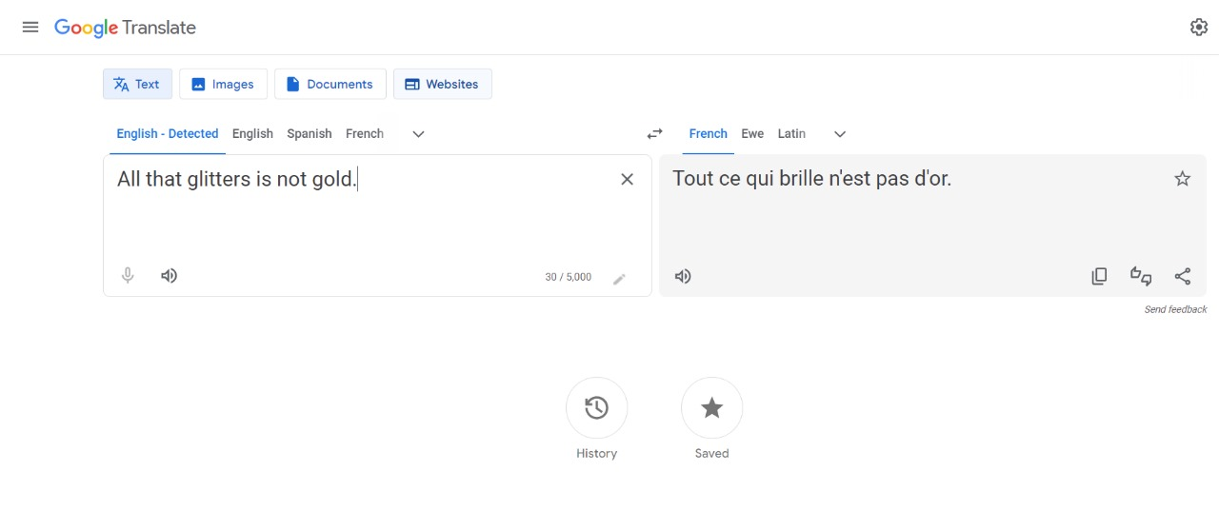
Google’s Neural Machine Translation
It generates text in different languages using artificial intelligence and machine learning. It is powered by google
Example :

Slide 7
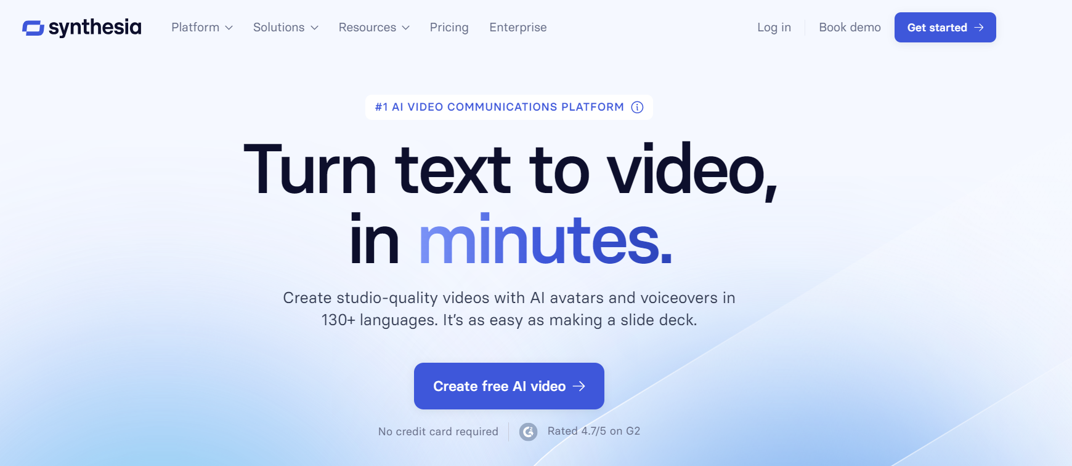
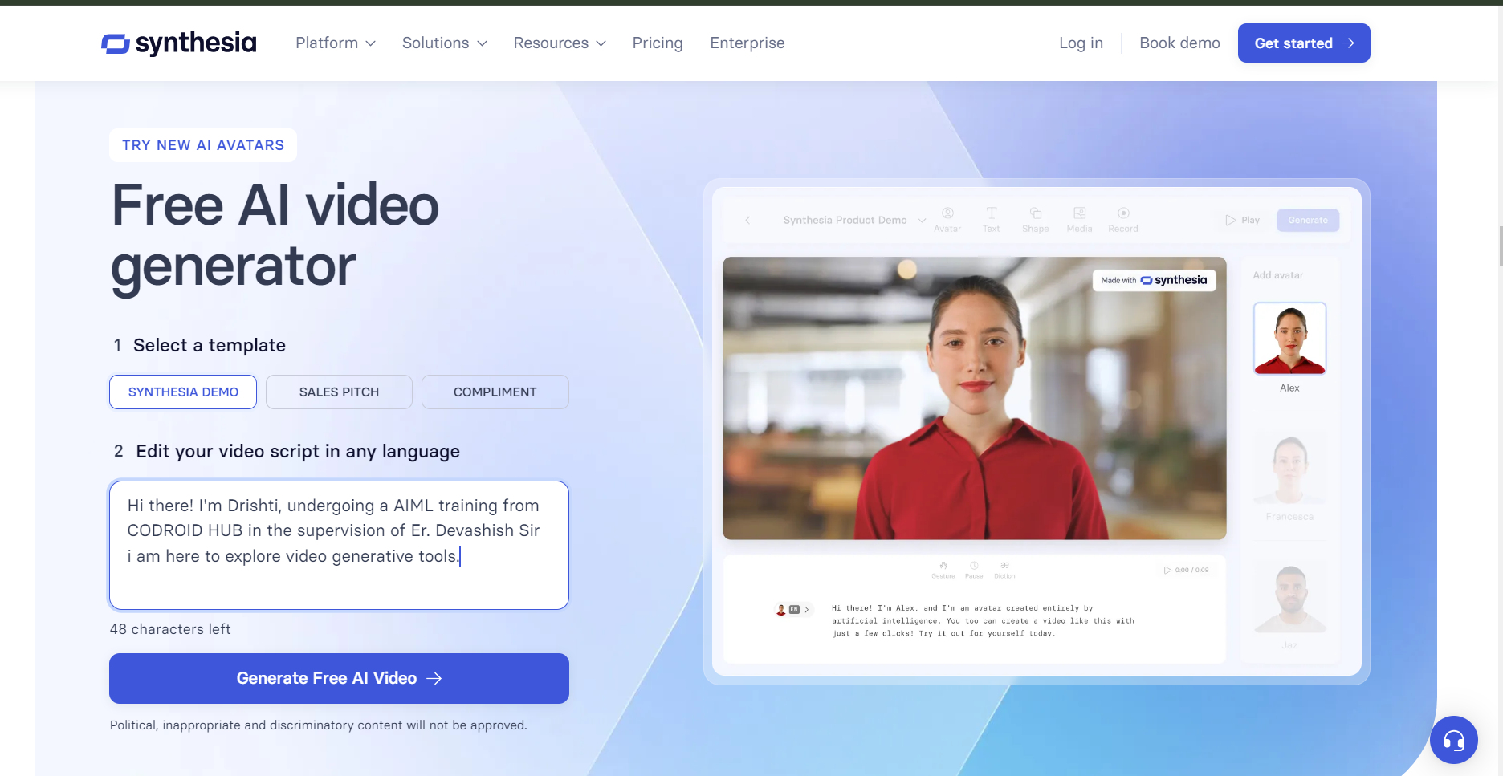
Synthesia
Provide wide range of video content reducing time, cost, complexity. It includes personalized avatars and voiceover without needing traditional video production tools.
Example :

Slide 8
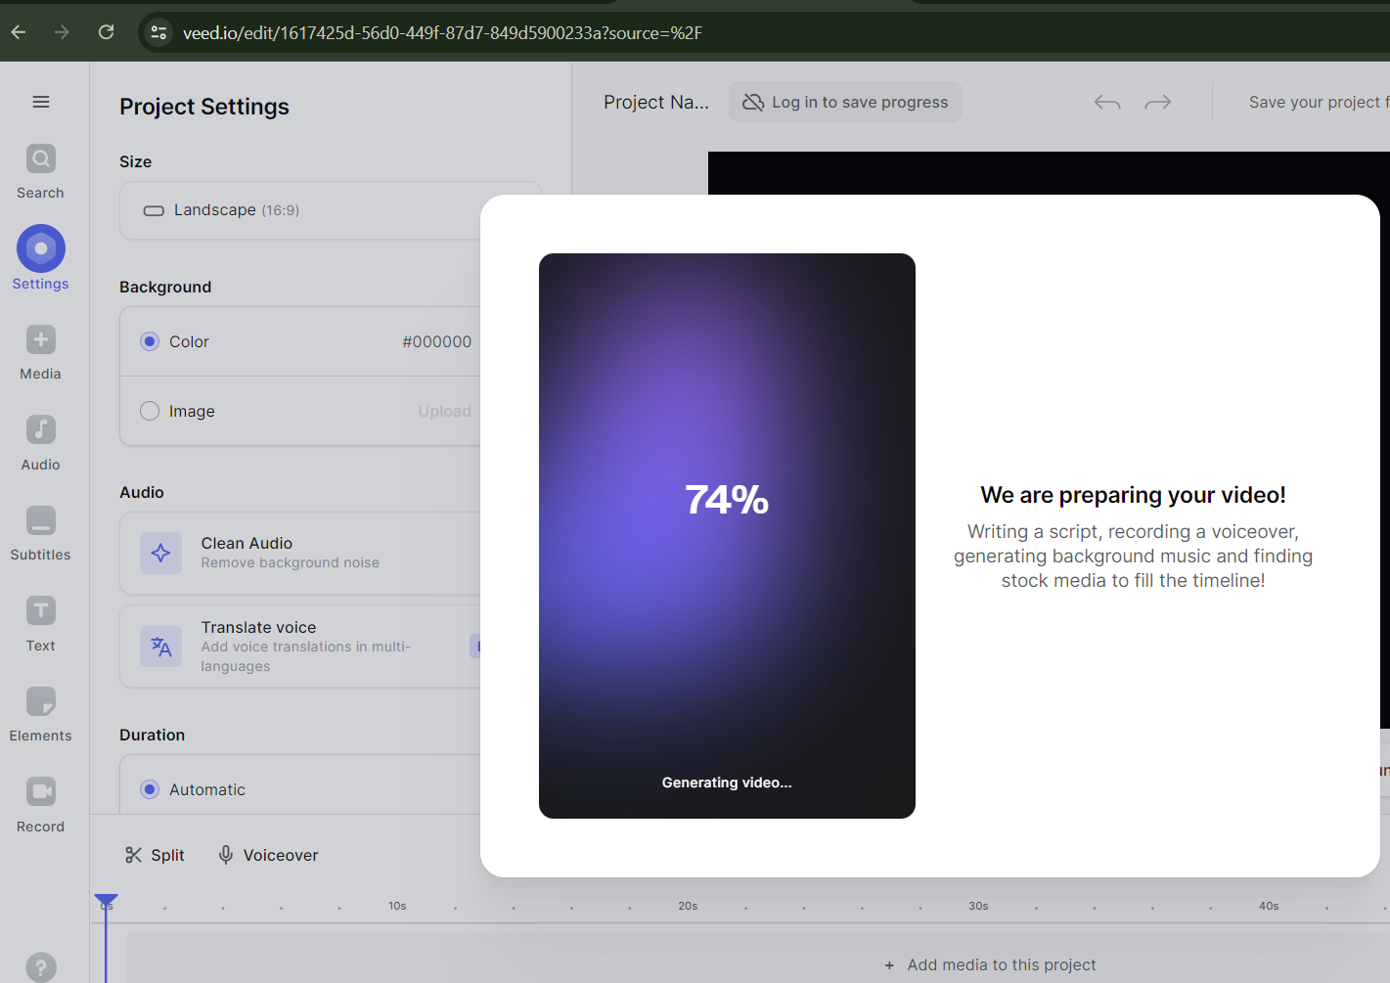
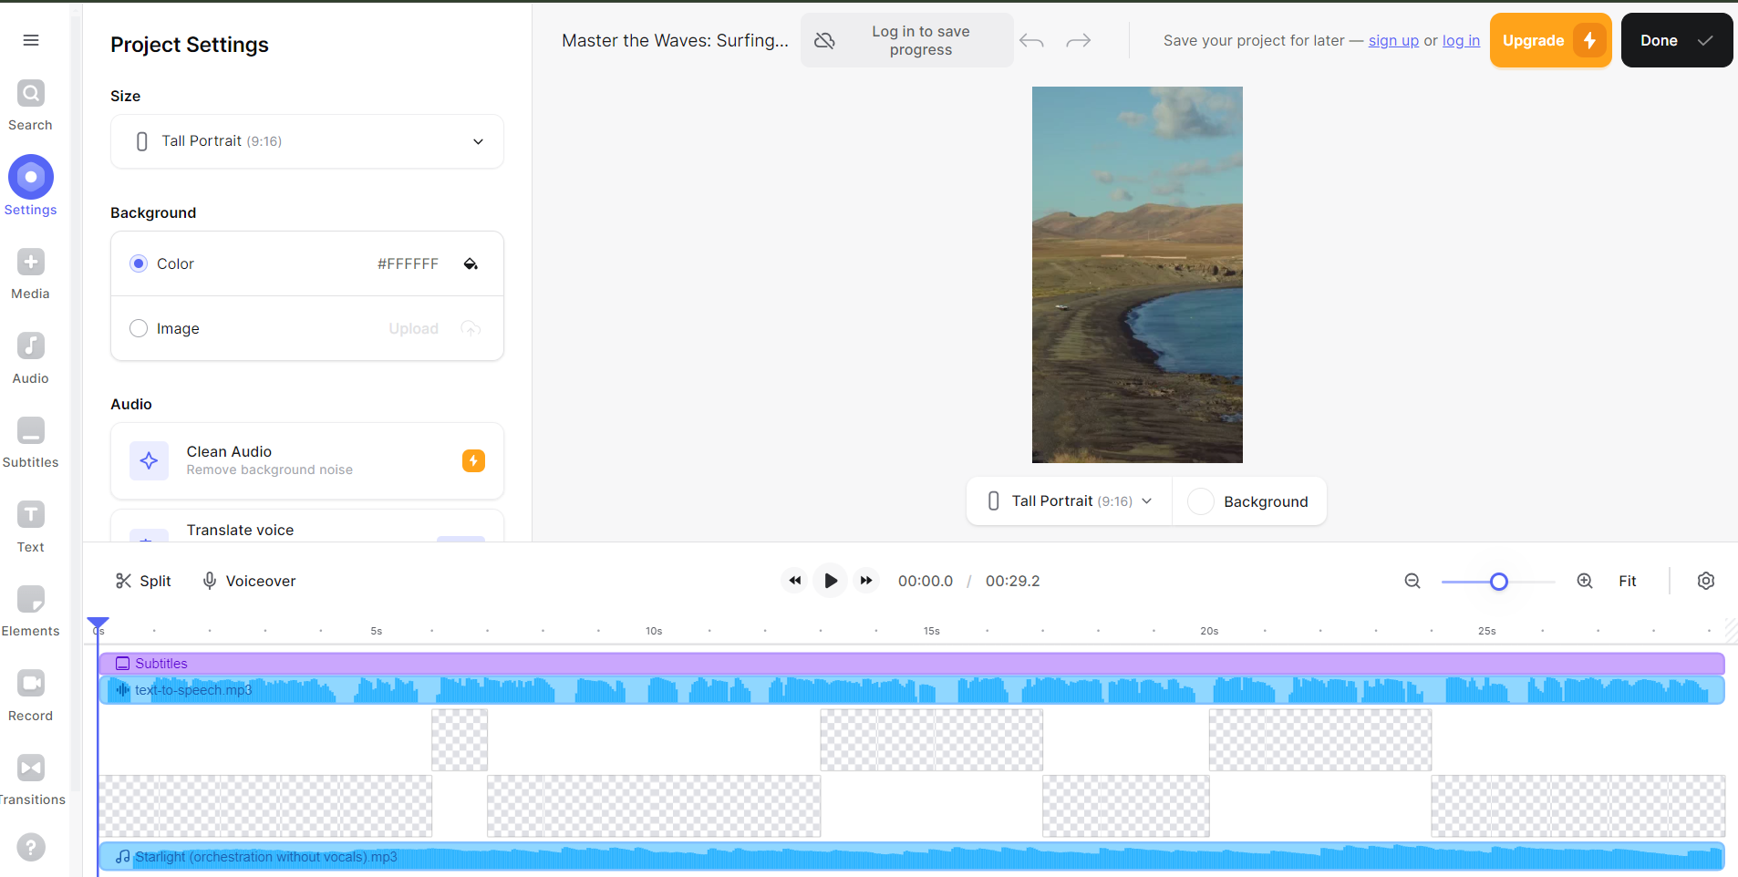
VEED.io
It is a video editing tool that allows user to create, edit and share videos with ease. It offers features like automatic subtitles, video trimming, adding text and animations, and converting audio to text.
Example :

Slide 9
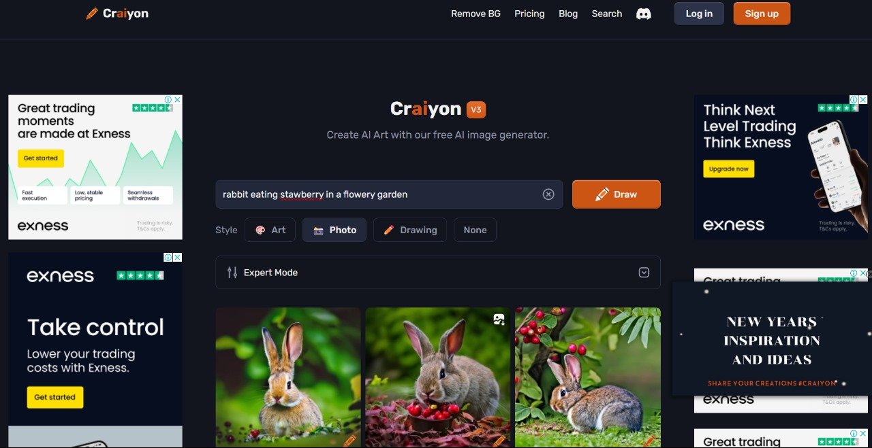
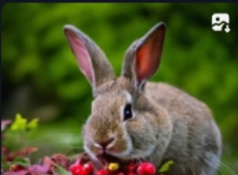
Crasiyon
Generate images using textual description or detailed images based on input prompts.
Steps :
Creating realistic images with AI starts with, you guessed it right... the prompts.
You're going to learn our best hacks to turn your words in to super realistic images.
Here are some friendly tips when making photorealistic AI images.
Example :

Slide 10
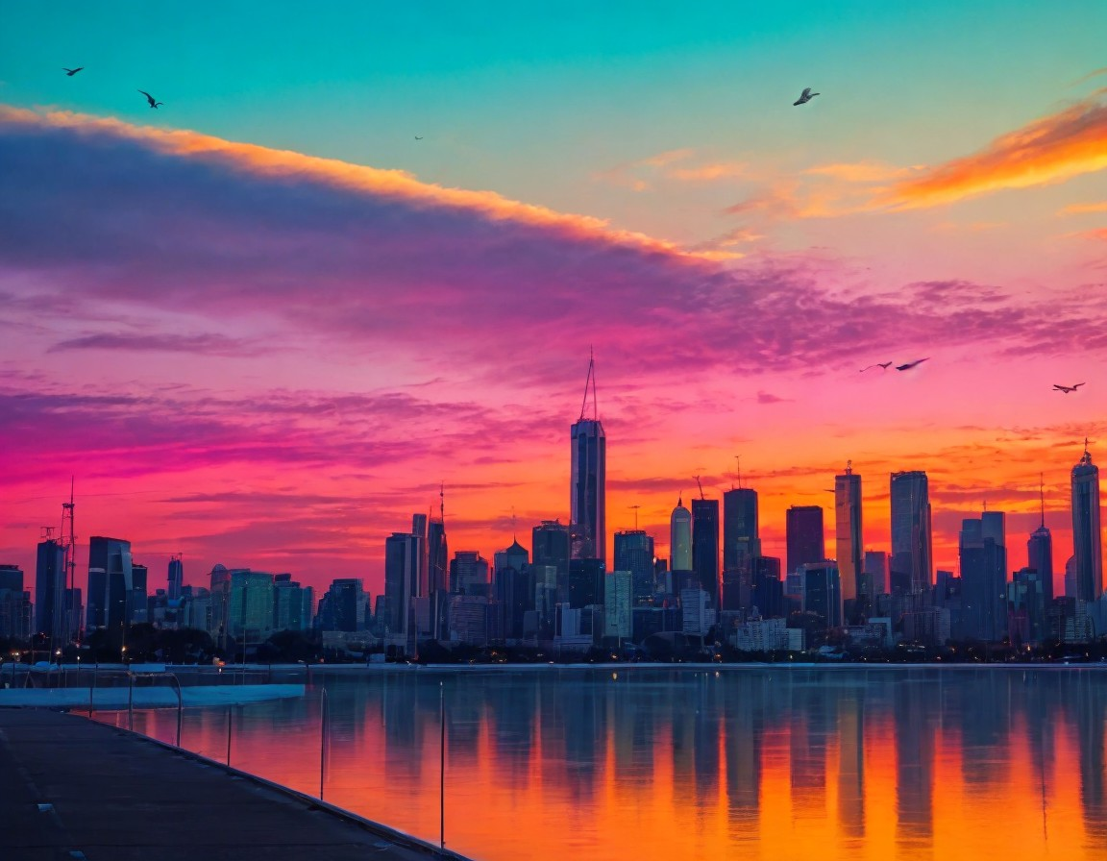
Google’s Deep Dream
It is a computer vision program uses deep learning to find and enhance the pattern in images via algorithm thus, creates dream like appearances.
Example :

Slide 11
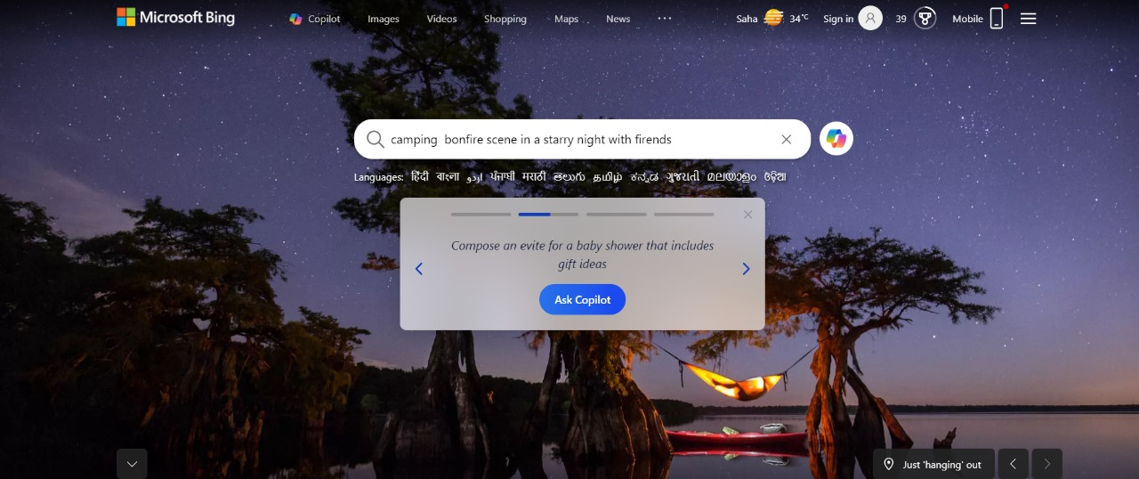
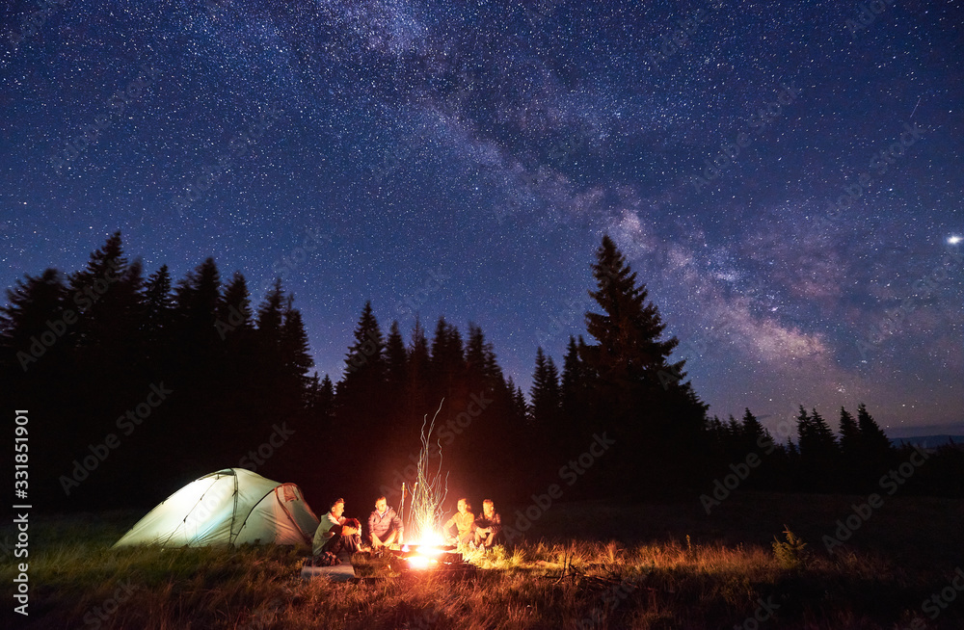
Bing
It is a Microsoft search engine you can use it for web search, image search , news and much more.
Example :

Slide 12
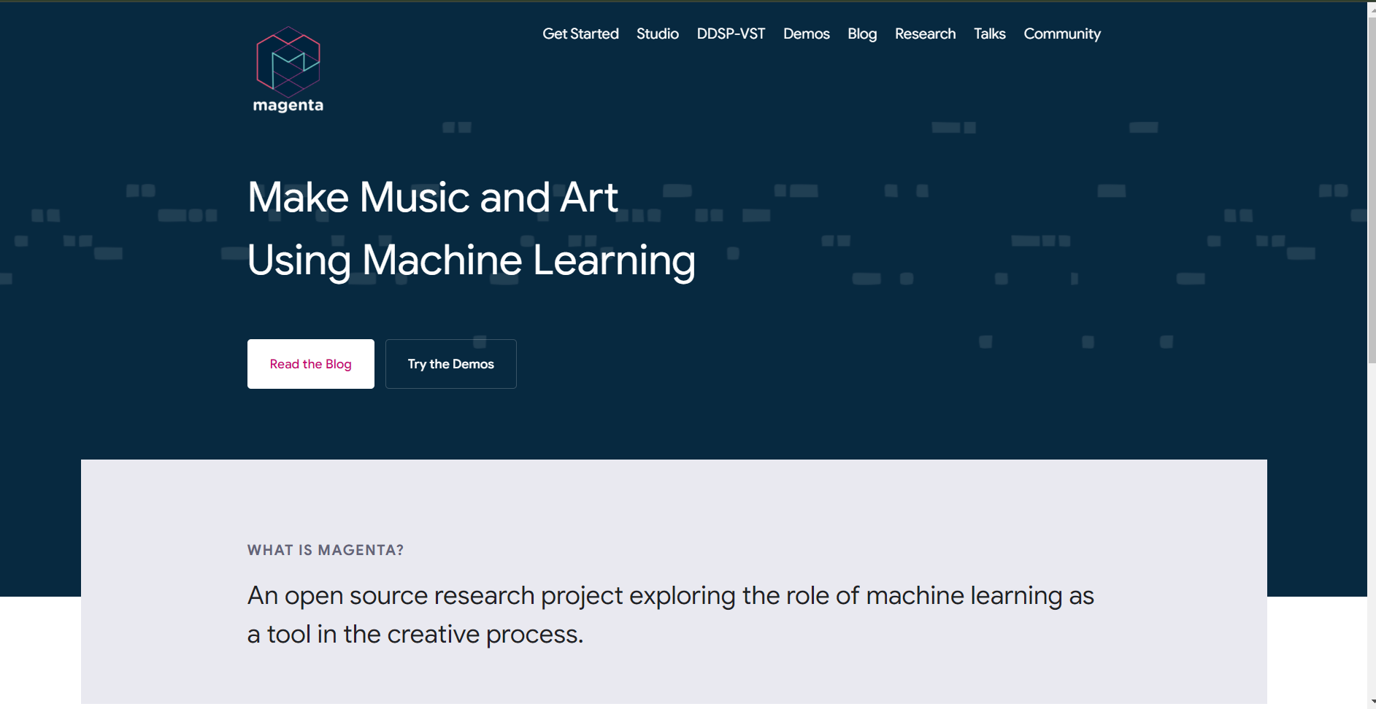
Magenta
It is a google research project and it provide ML models and tools to assist artists, musicians, and creating new forms of art and music.
Example :

Slide 13
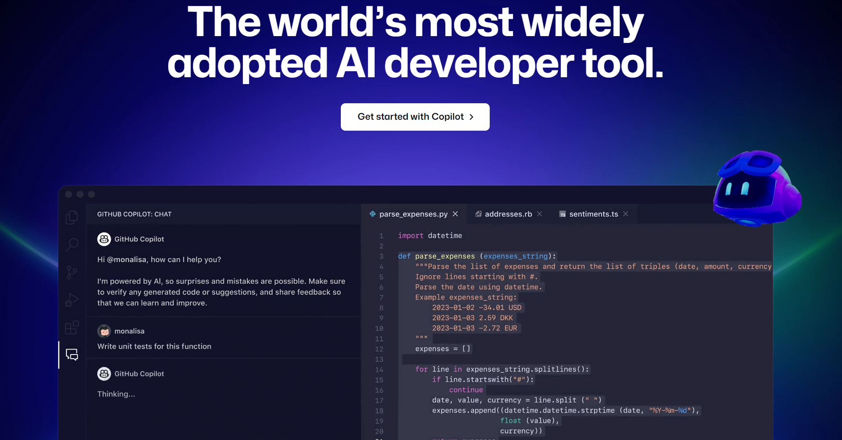
Github Copilot
It is a AI powered code completion tool it assist developers in writing code faster and more efficiently.
Example :

Slide 14
LINKS :
CHAT GPT | Open AI chat GPT
Google’s Neural Machine Translator | Translate.goole.com
Synthesia | Synthesia.io
VEED.io | VEED.io
Craiyon | Craiyon.ai / craiyon.com
Google’s Deep Dream | Deep dream generator
Bing | Bing.com
Magenta | Magenta.tensorflow.com
AIVA | aiva.ai
Github Copilot | Copilot.github.com
Amazon Code Whisperer | Amazon Code Whisperer / https://docs.aws.amazon.com

Slide 15
Thank you

